Slide 1


Smart Tank – IoT Project
Computer Systems & Networks Assignment 2
HDIP in Computer Science
WIT
Israel Finnerty

Slide 2



Smart Tank Never run out of oil again!
Smart Tank takes accurate readings from your oil tank and relays them directly to your dashboard on our website. SmartTank will notify by email and Twitter when your oil is running low. You will be prompted to request oil refill quotes from your local oil providers via your dashboard.
If you have smart heating technology Smart Tank will also disable your heating until your tank has adequate levels of heating oil avoiding air locks and avoiding the need to bleed the boiler.
Smart Tank can be retro fitted to any existing oil tank or added to the factory design of new oil tanks.
“Smart Tank – taking the stress out of oil heating”

Slide 3
Smart Tank Overview
The prototype will be installed in the cap of the oil tank and use an ultrasonic sensor connected to the Raspberry Pi to measure the levels of oil in the tank. Home heating oil tanks are within close proximity to the dwelling therefore the prototyped device can utilise the home wifi , 802.11,to deliver readings to the IoT platform and the end user. The end user will be able to monitor the levels of oil in the tank. The device will also connect to other smart home devices such as smart thermostat to disable the heating system if there is insufficient oil in the tank preventing air locks.
When oil is running low the user will be asked if they would like to receive quotes on refills or part refills from local oil distributors. The user is prompted to to request these quotes via their dashboard, which displays their local oil providers from a Cloud Based SQL Server. When the form is submitted the website uses PHP to get the email addresses of the local oil providers and sends them an email with the user details requesting a quote based on the users demand.
Smart Home Device

Slide 4


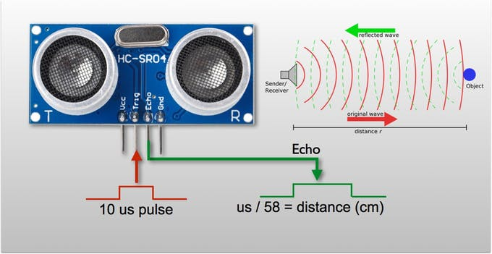
Ultrasonic Sensor Function

Slide 5
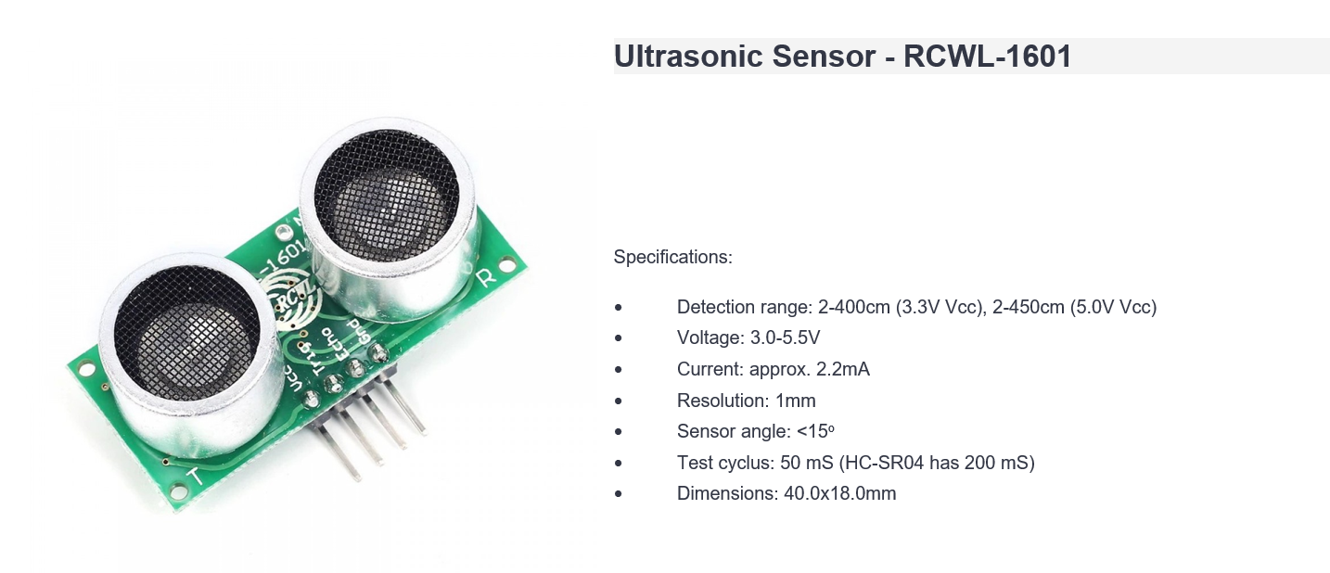
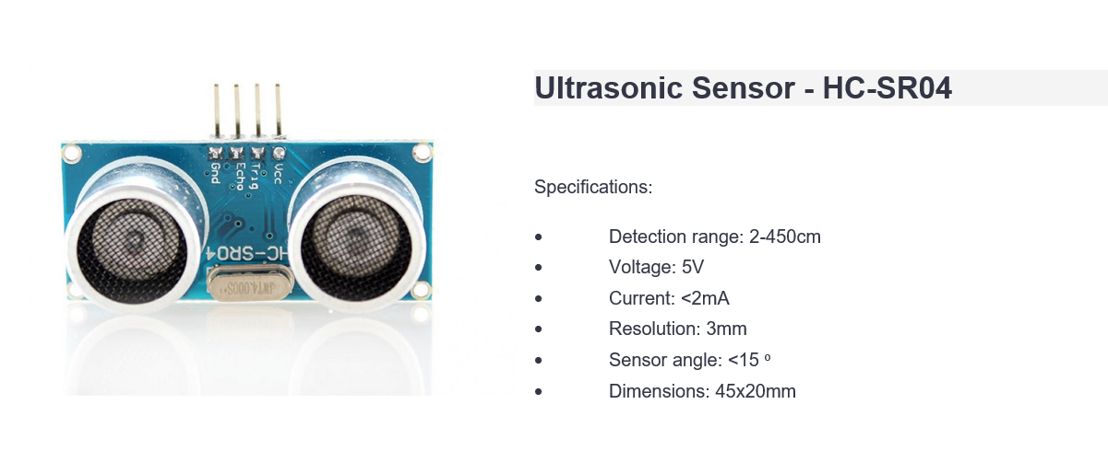
Which Ultrasonic Sensor?

Slide 6
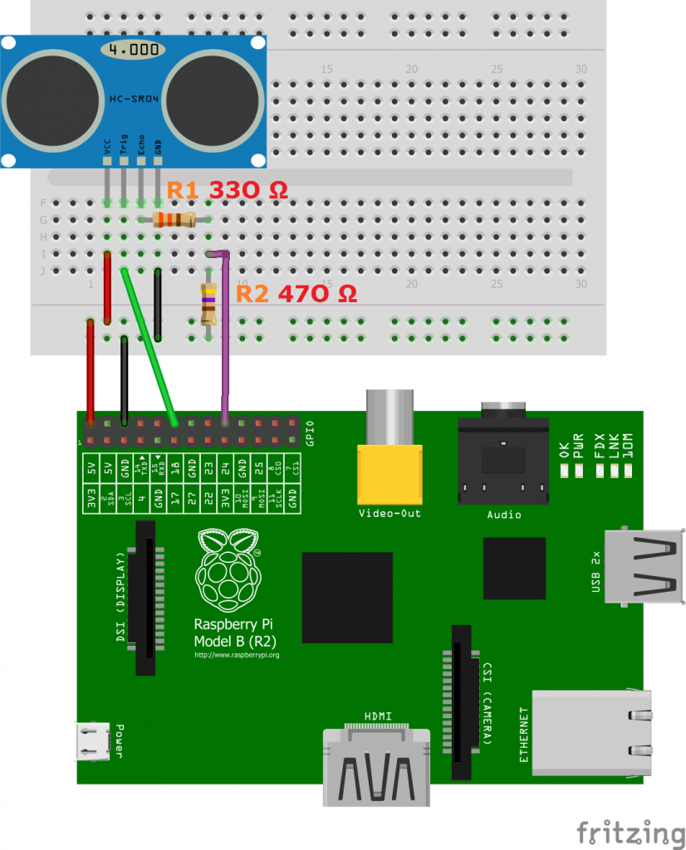
HC-SR04 Sensor Configuration
Connection to Pi via electronic breadboard and resistors

Slide 7
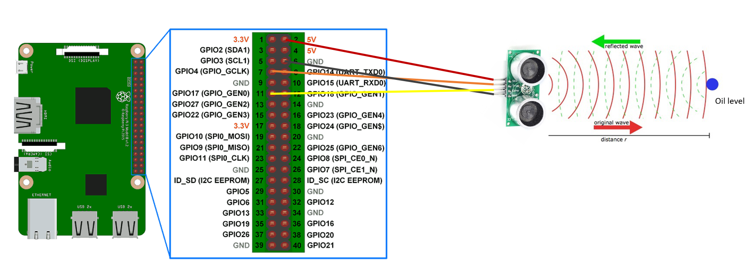
RCWL - 1601 Sensor Configuration
Direct connection to Pi GPIO pins

Slide 8
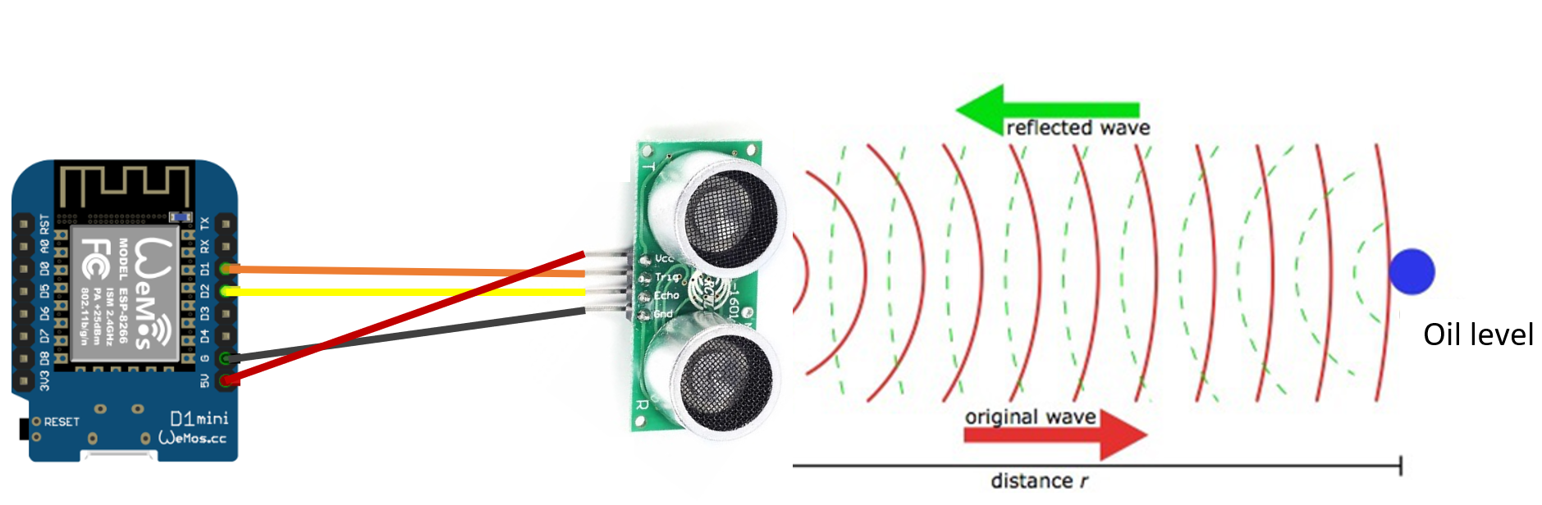
Alternative Prototype Sensor Connection with ESP-8266 Microcontroller

Slide 9

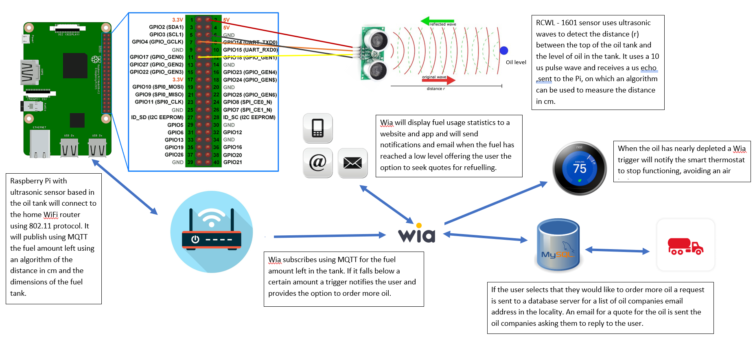
Proposed Pictorial Information Flow Representation

Slide 10
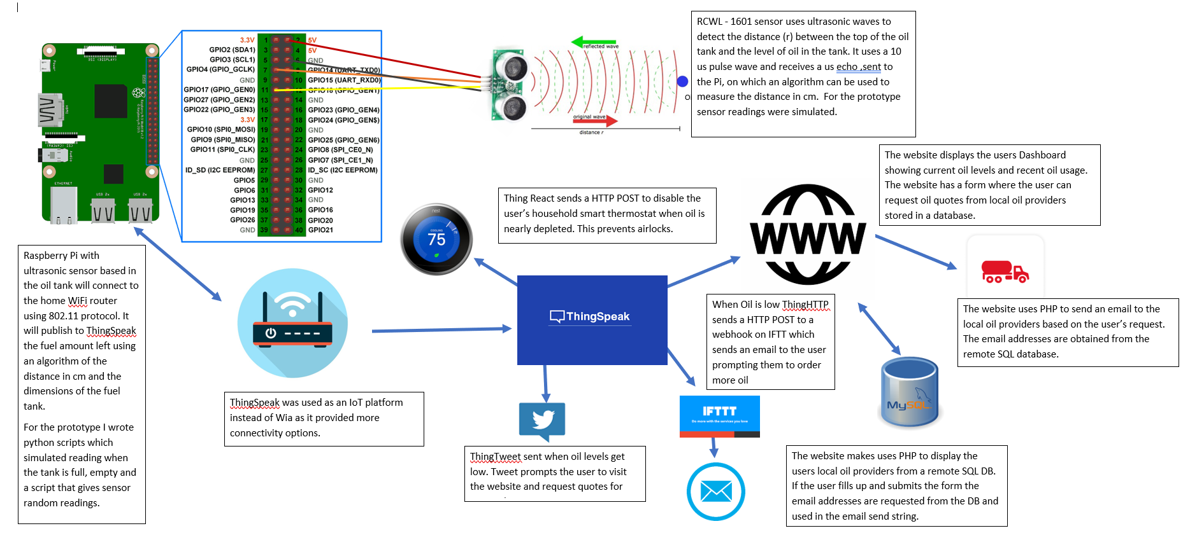
Final Pictorial Information Flow Representation

Slide 11
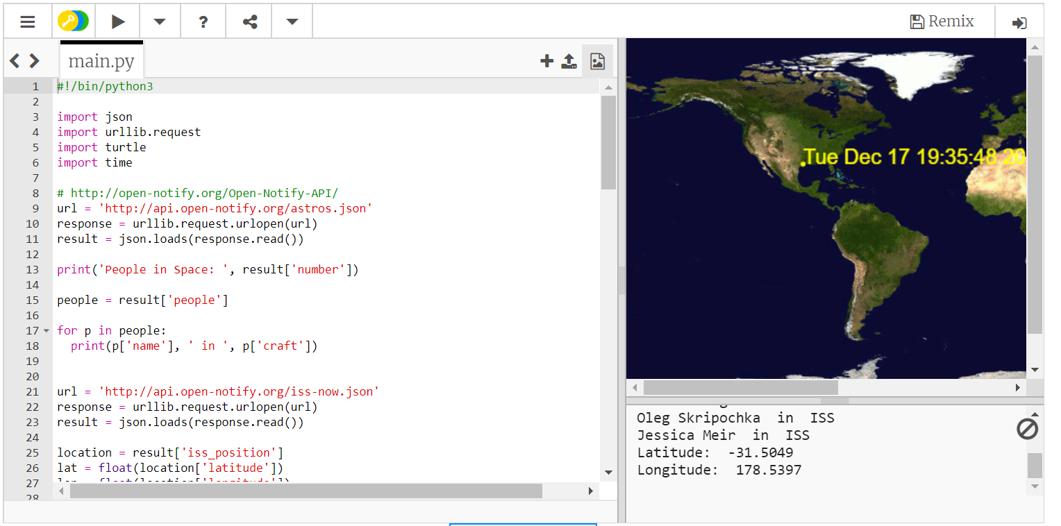
Developed Python Knowledge

Slide 12
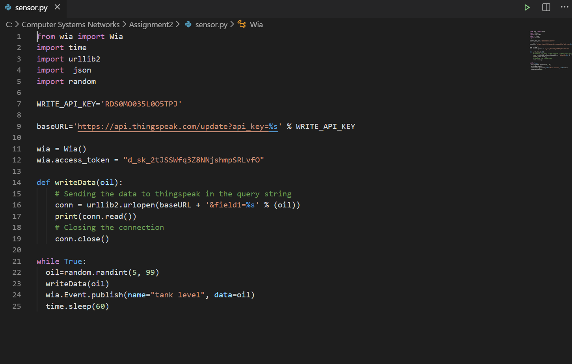
Used Python Scripting to Write to ThingSpeak

Slide 13
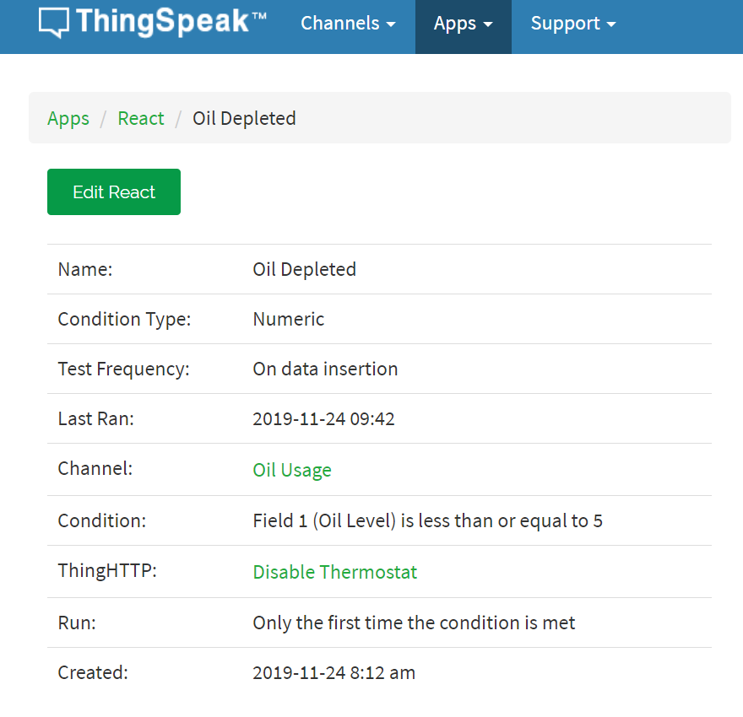
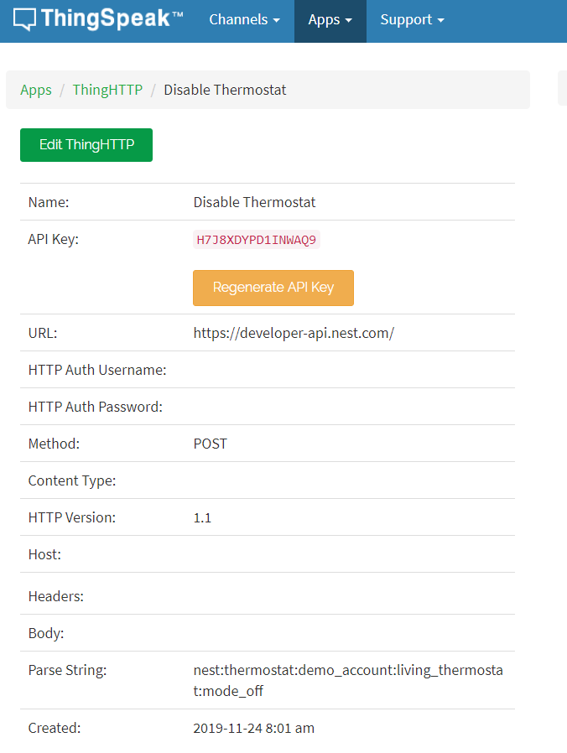
Configured IoT Platform – Thing Speak

Slide 14
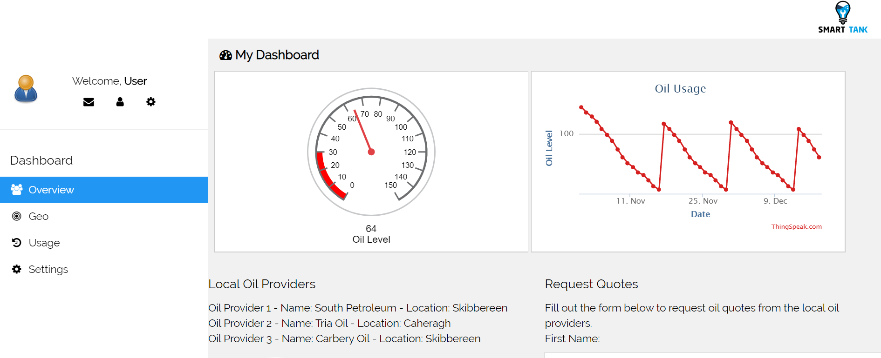
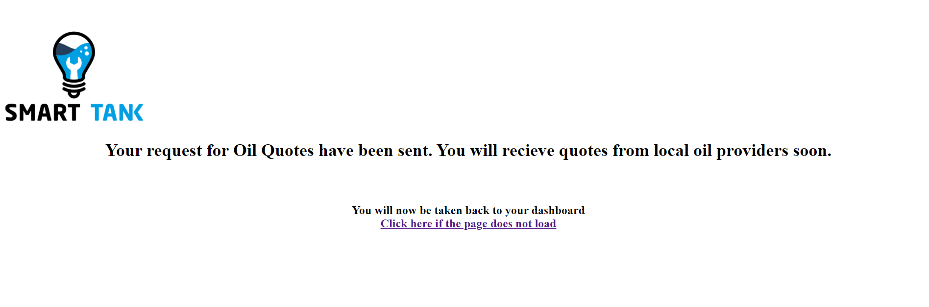
Developed the Website and deployed using FTP

Slide 15
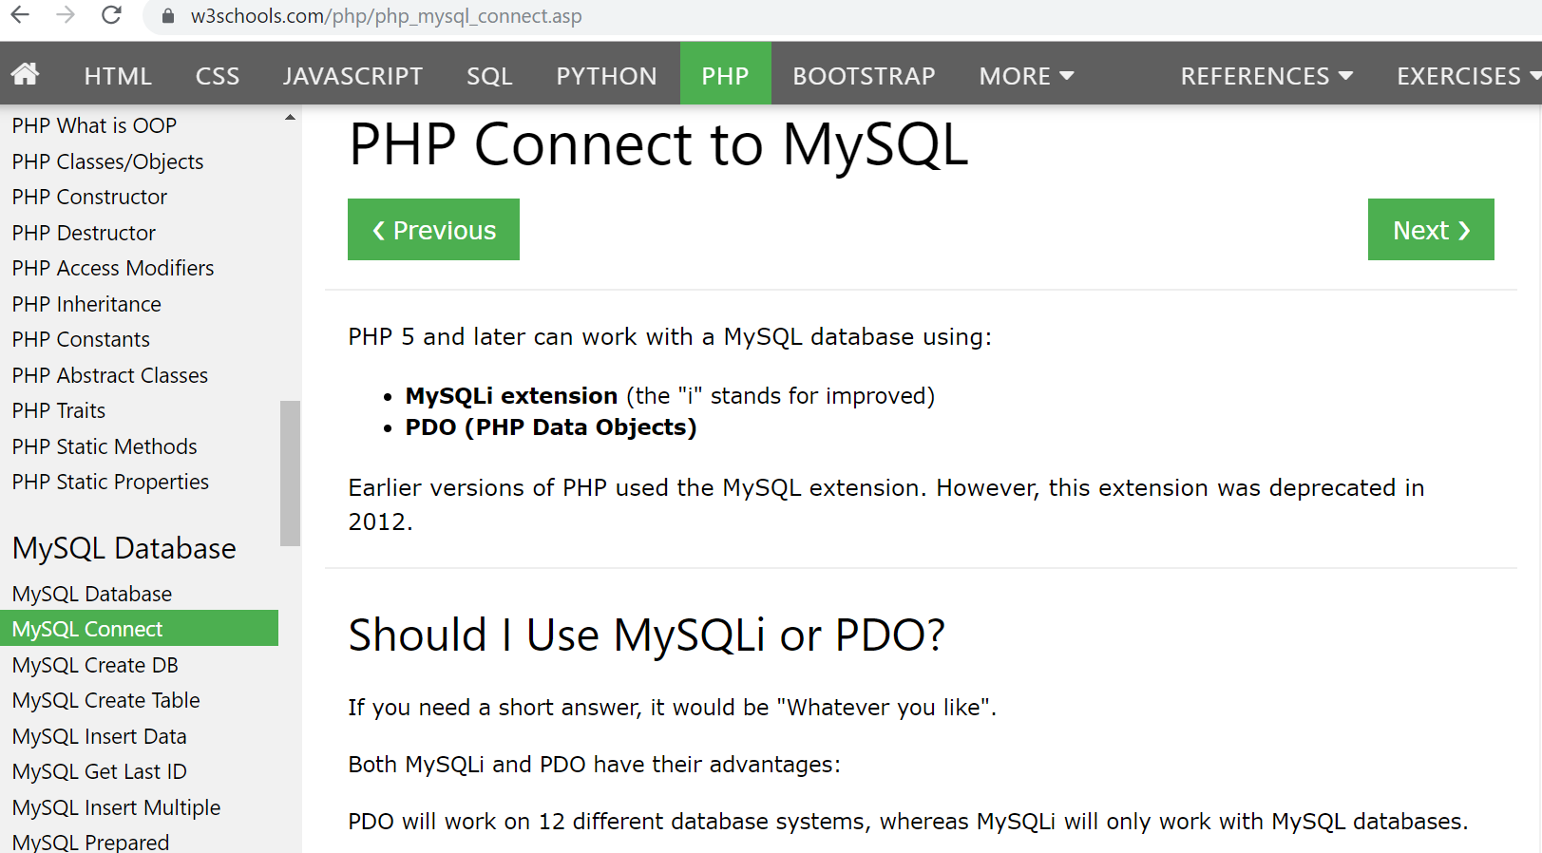
Learning PHP and Connecting to SQL

Slide 16
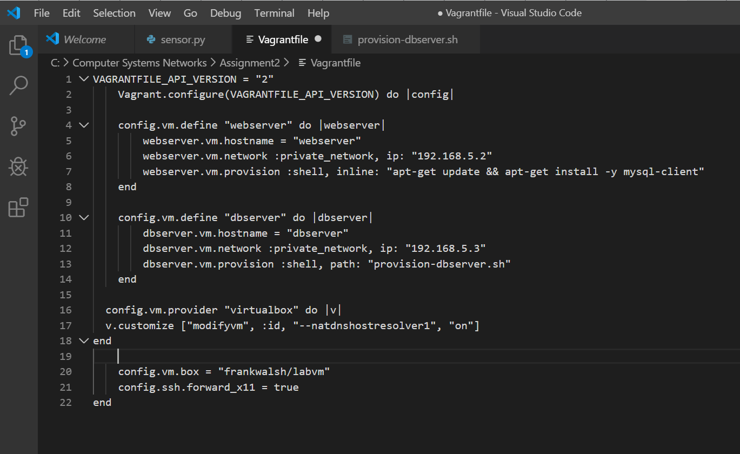
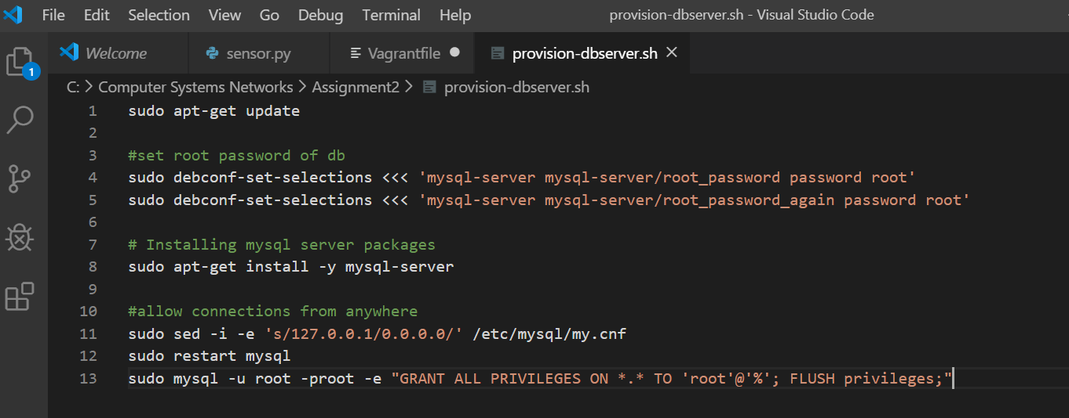
Provisioned DB Server using Vagrant

Slide 17
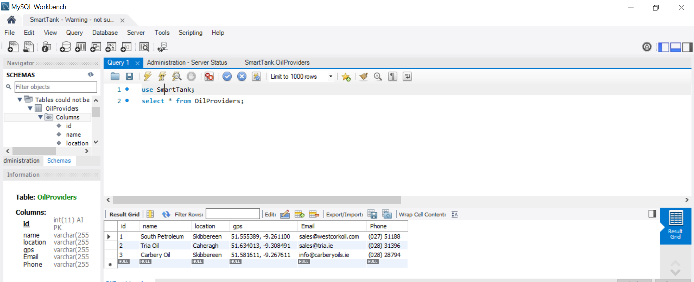
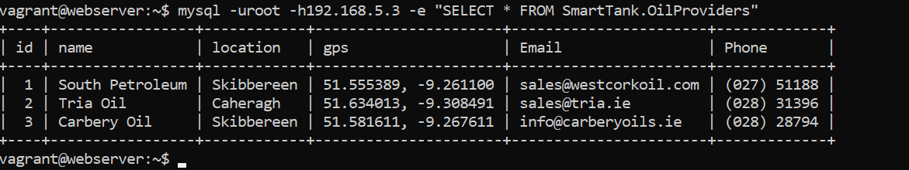
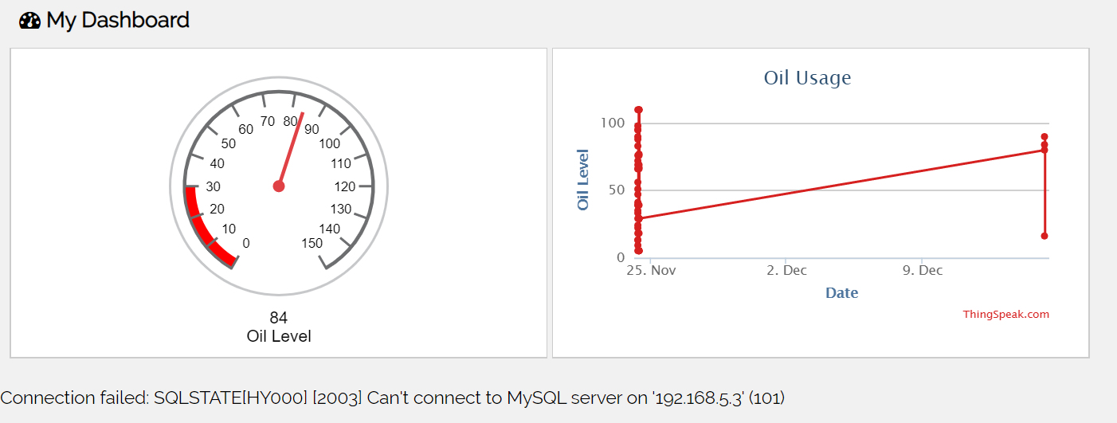
Connecting to VM DB Server

Slide 18

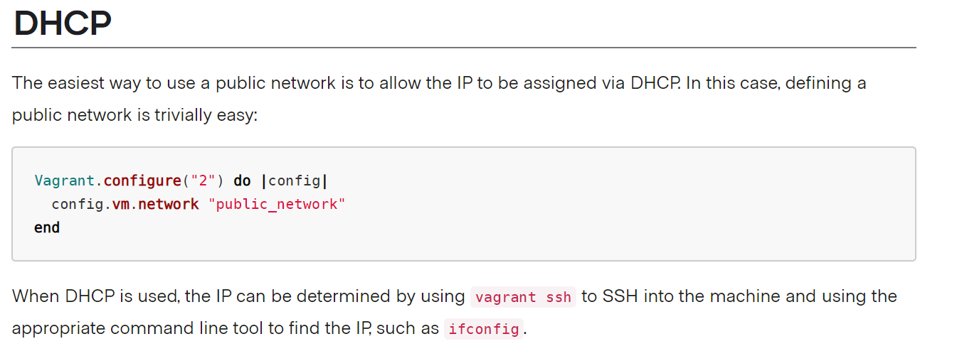
Troubleshooting VM DB Connection Issues

Slide 19
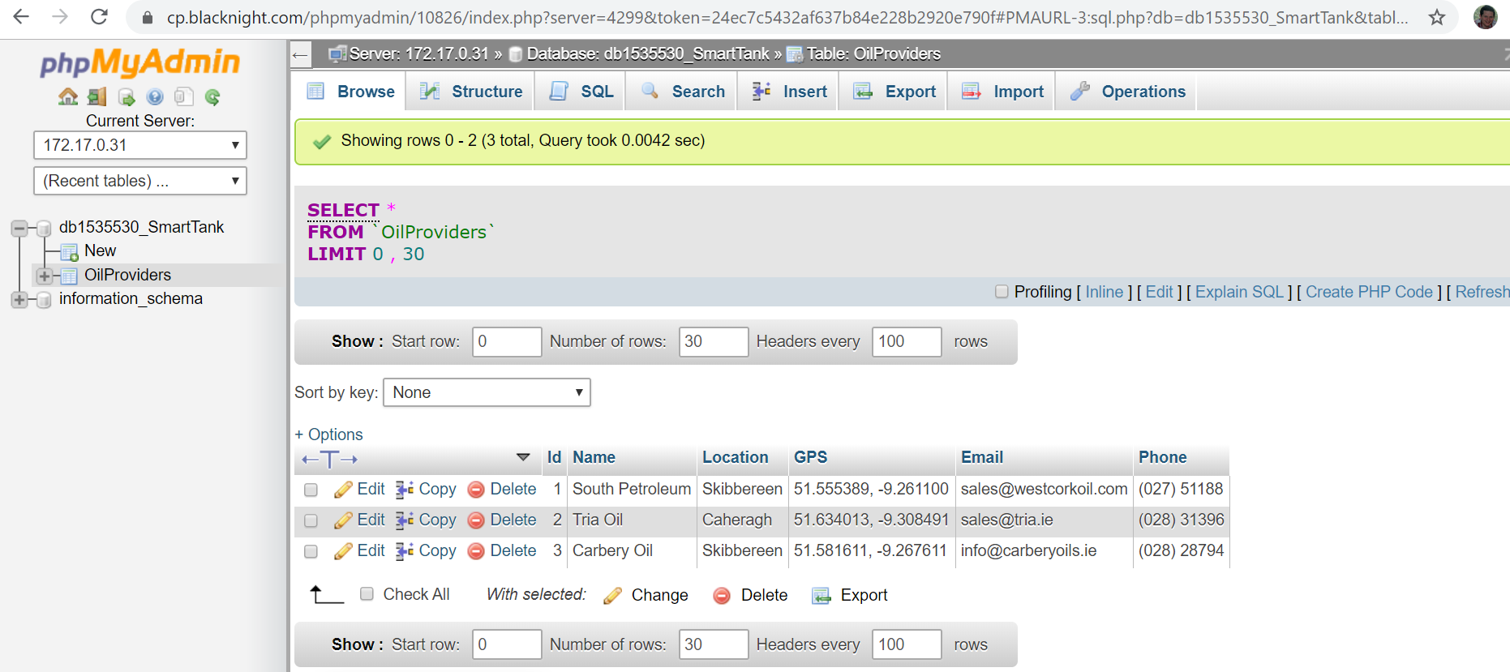
Using Remote Cloud SQL DB Server

Slide 20
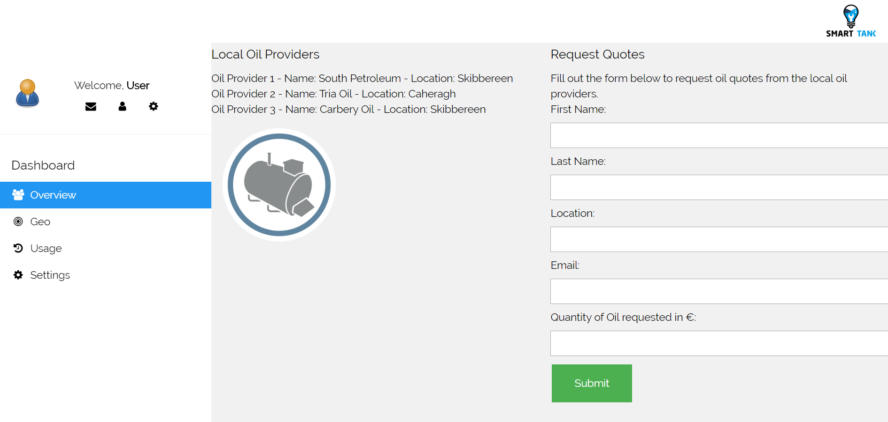
Connected Website to Cloud SQL DB using PHP

Slide 21
Learning
IoT and Cloud based platforms make life easier.
When choosing a sensor it is important to research the electronic requirements.
PHP is cumbersome but effective with SQL.
Project plans can adapt and evolve throughout development.
Python is an efficient language.

Slide 22

Thank You
Smart Tank – IoT Project
Computer Systems & Networks Assignment 2
HDIP in Computer Science
WIT
Israel Finnerty

